Slide 1

Shamkya Mining Project
Integrating geology, geochemical pathfinder analysis, and Python-based visualization to support early-stage exploration decisions in orogenic gold systems.
By:
Obay Salih &
Salih Adam

Slide 2
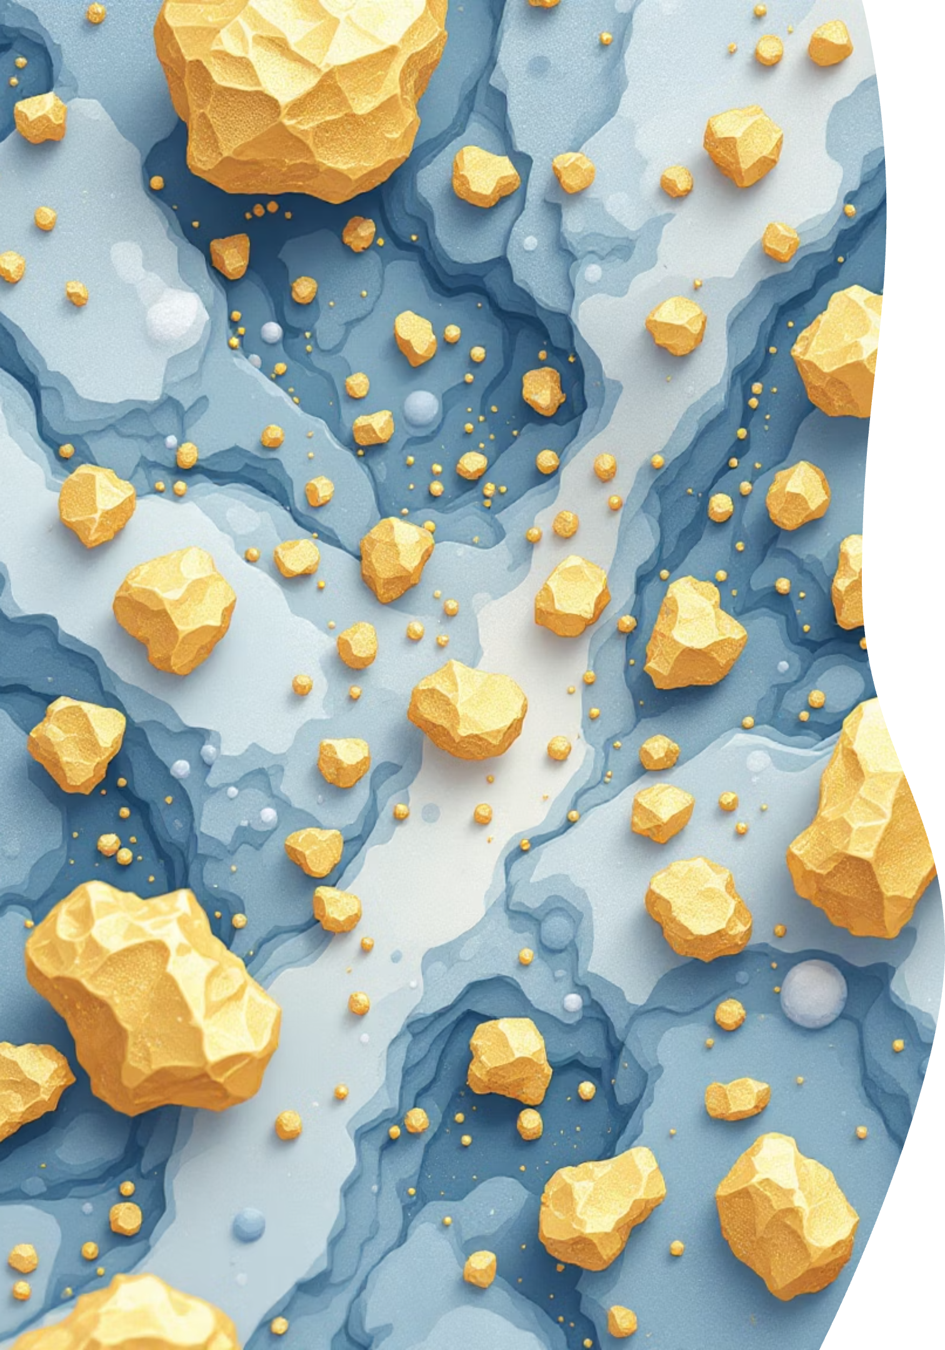



The Exploration Challenge
Nugget Effect Problem
Pathfinder Strategy
Extreme grade variability over short distances makes gold distribution highly irregular in orogenic systems.
Focus on associated elements and geochemical ratios to reduce uncertainty and identify core mineralized zones.
Spatial Analysis
Multi-element vectoring tools help distinguish proximal high-grade zones from distal background geochemistry.

Slide 3

Data Sources and Integration
Sample Collection
Final Dataset
ALS assay results from multiple sample types:
1,754 samples after cleaning and merging with complete spatial coordinates and geochemical data.
Diamond drill core
Reverse circulation (RC) chips
Key elements: Au, As, Sb, Bi, Zn, Ag, Cu
Trench and channel samples
This forms the foundation for geochemical analysis, statistical modeling, and 3D visualization.
Grab samples from surface exposures

Slide 4




Gold Distribution Characteristics
Strong Positive Skew
Histogram reveals numerous low-grade samples with a few extremely high-grade outliers.
Spatial Clustering
2D contour maps and 3D surface models visualize concentrated high-gold zones within the project area.
High-Grade Shoots
Distribution pattern supports localized structural controls creating discrete mineralized shoots.
The spatial distribution of gold shows distinct clustering in the central-eastern portion of the property, consistent with structurally-controlled orogenic gold mineralization.

Slide 5
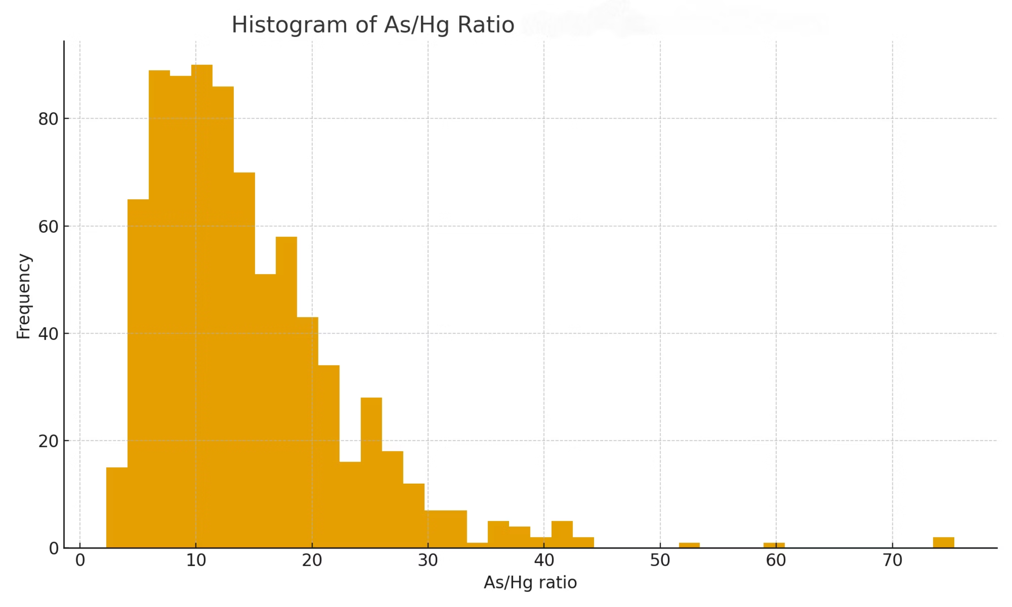

Slide 6
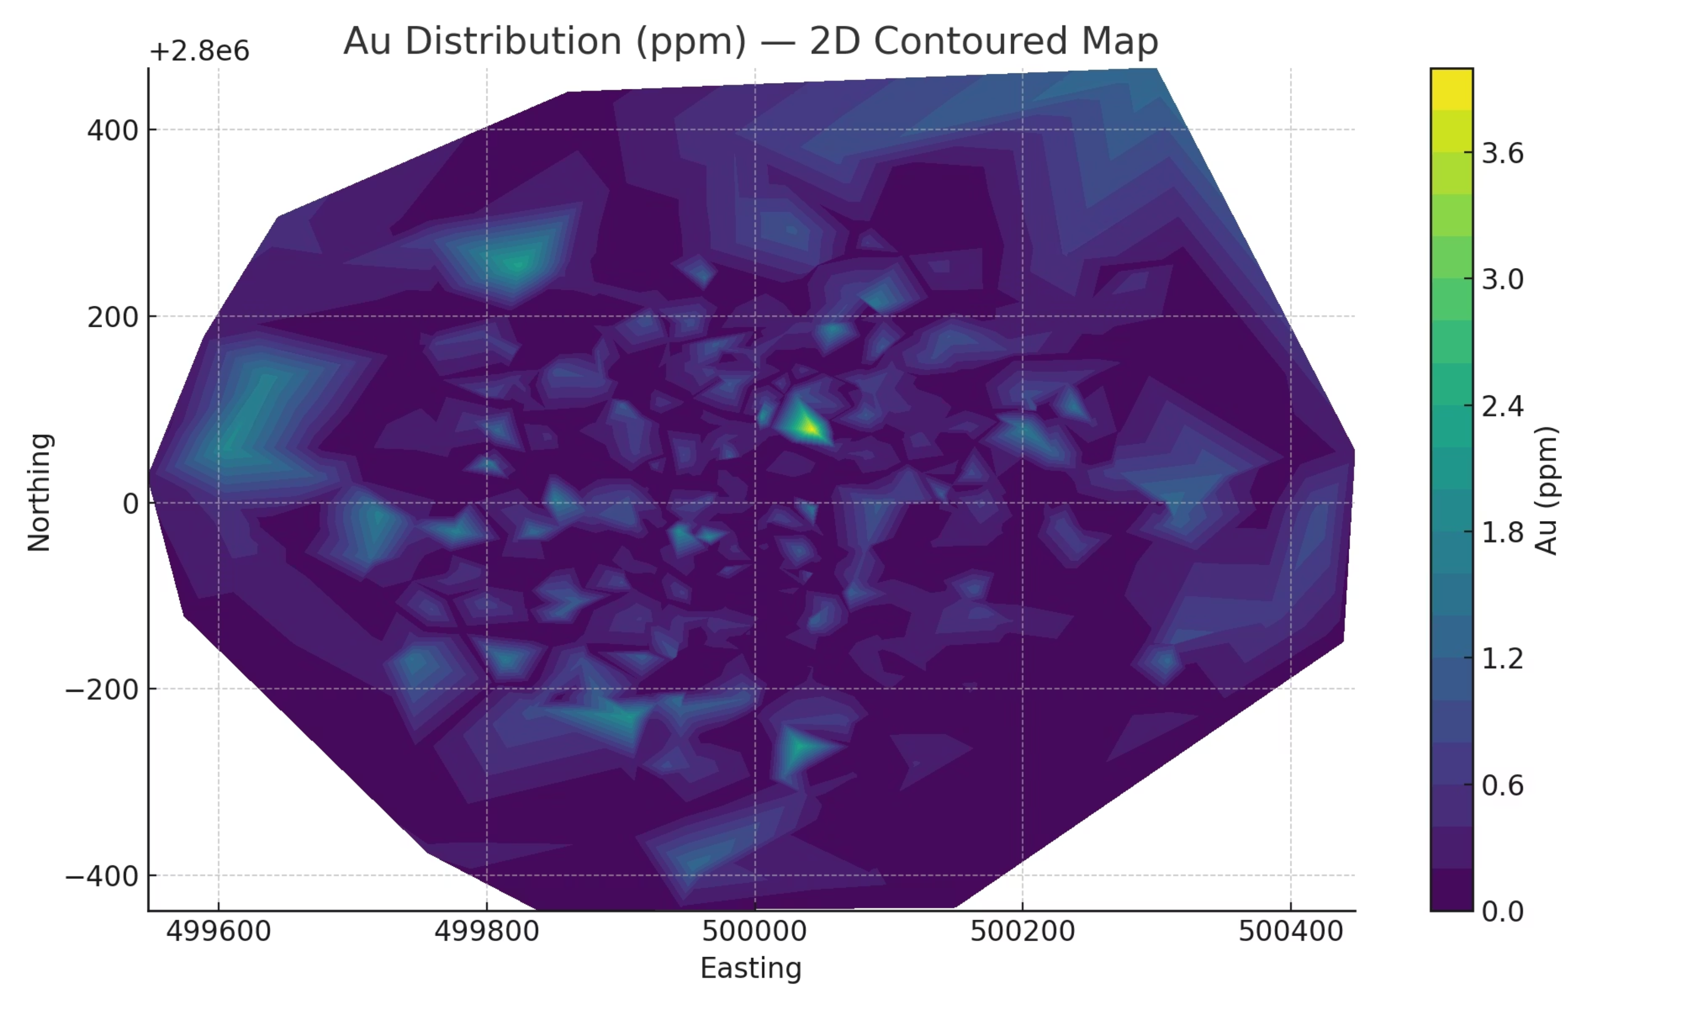

Slide 7
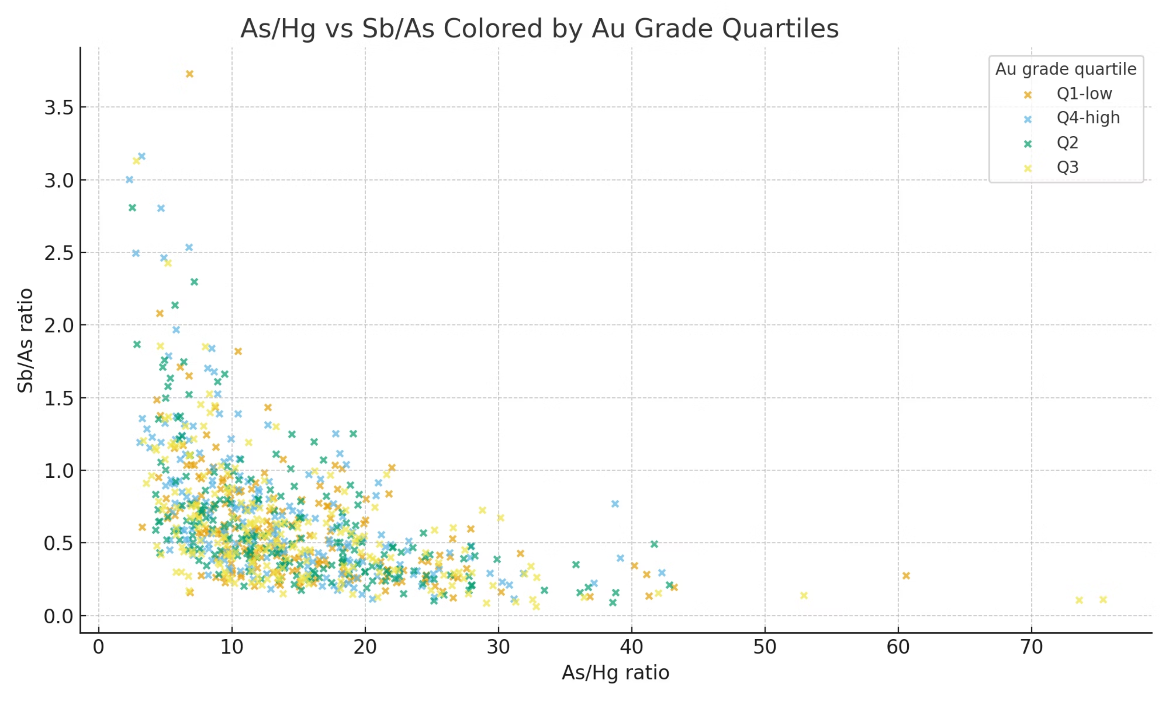

Slide 8
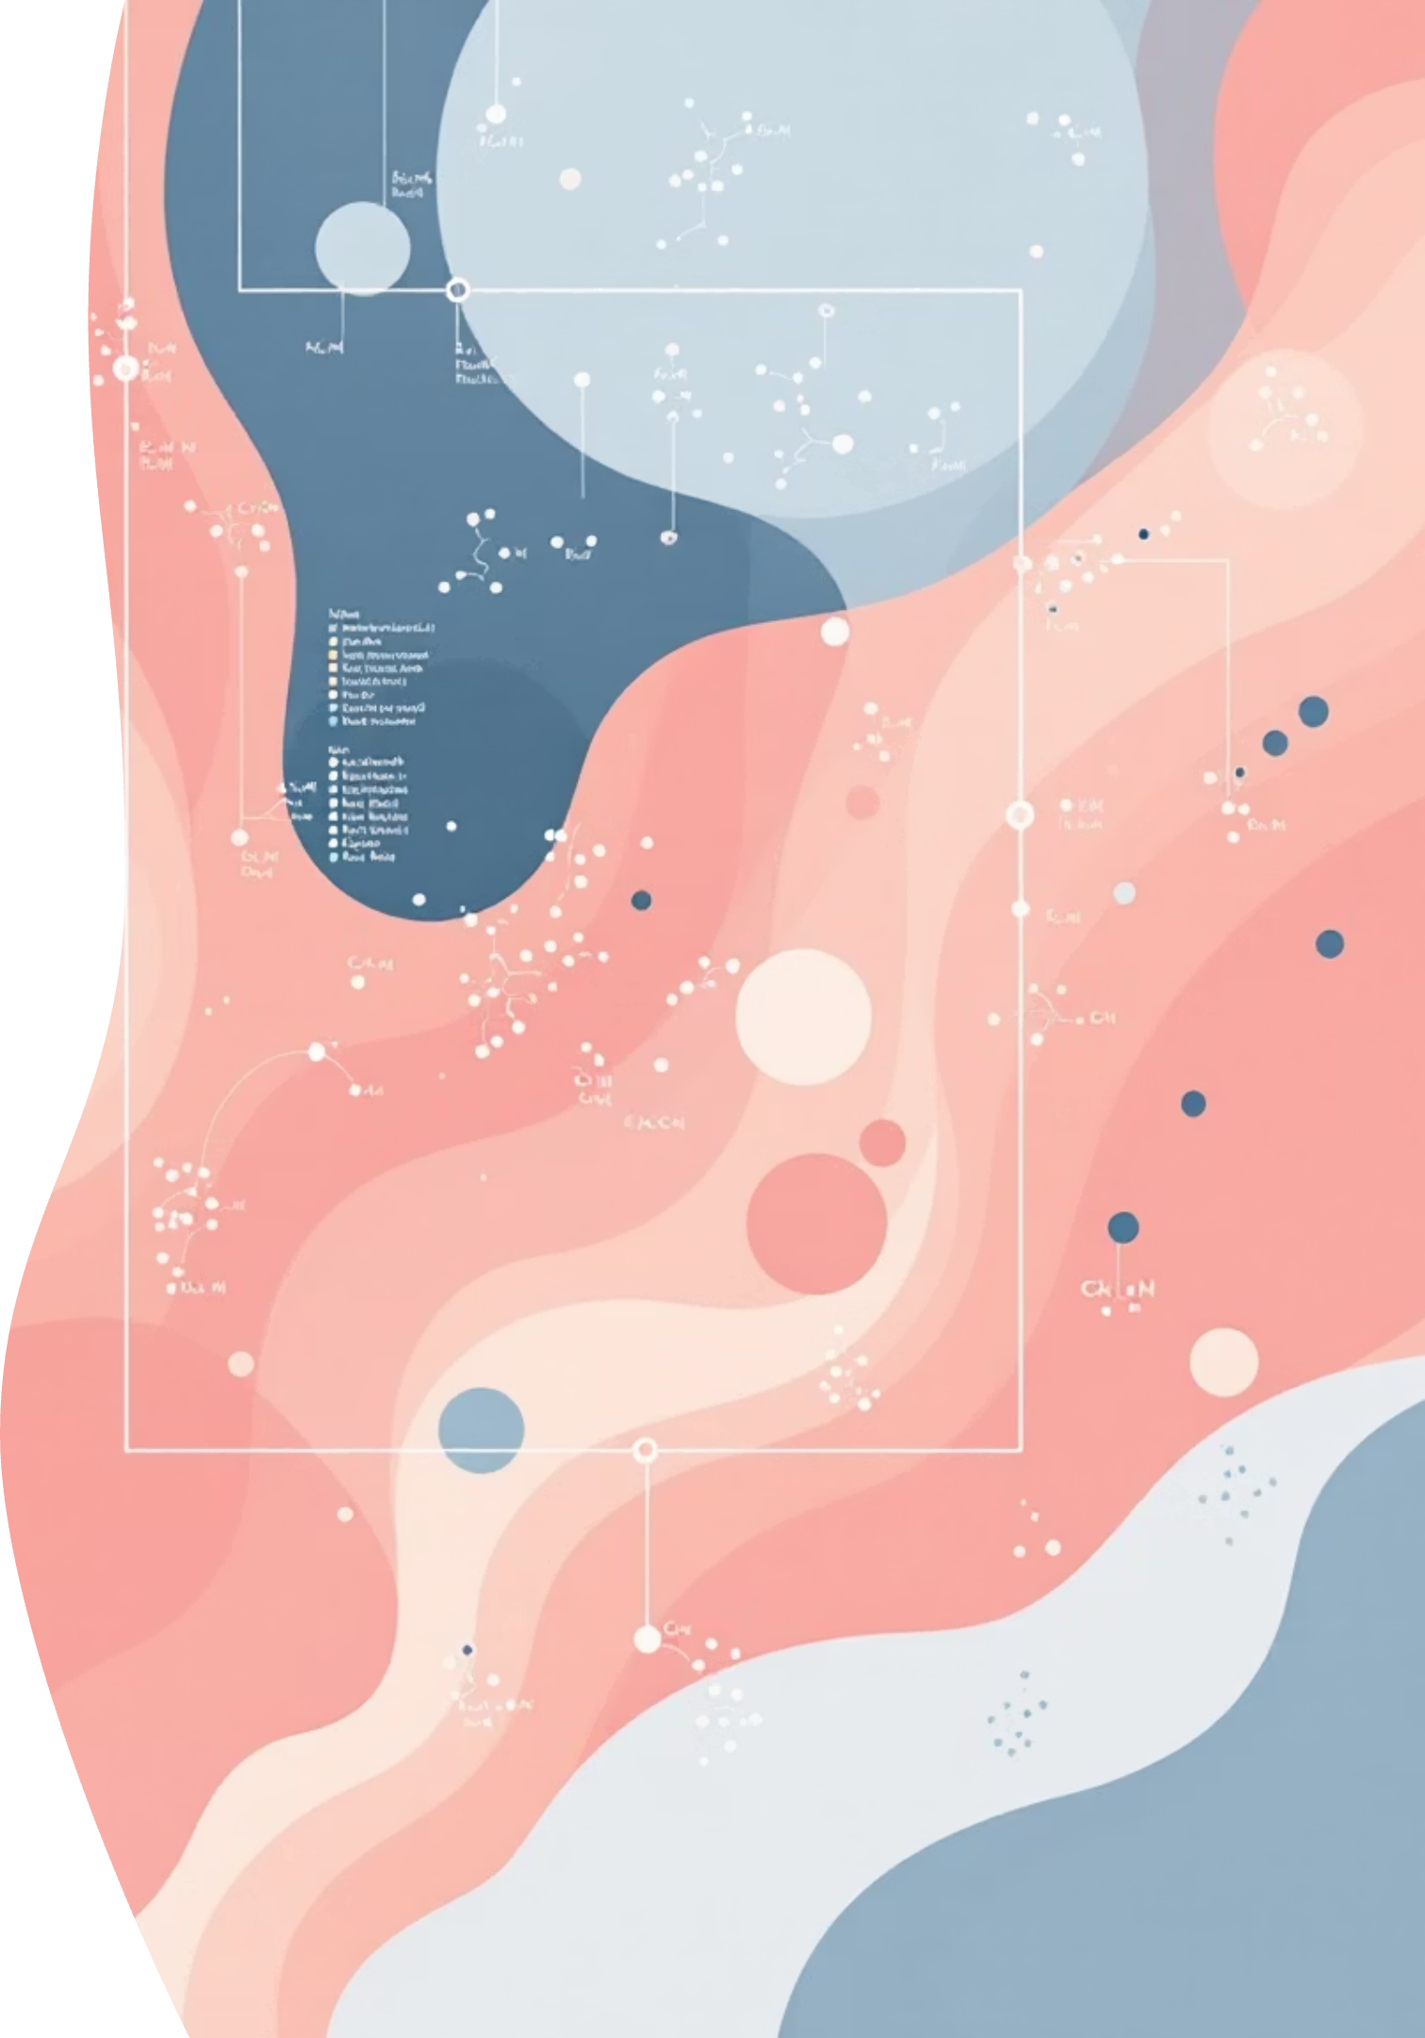
Pathfinder Element Correlations
1
Antimony (Sb)
Strongest positive correlation with gold. Key proximal pathfinder element in orogenic systems.
2
Silver (Ag)
Moderate positive correlation. Associates with gold-bearing sulfide assemblages.
3
Arsenic (As)
Positive but weaker than Sb. Common in broader mineralized halos.
4
Zinc (Zn)
Negative correlation. Represents distal zones away from gold concentration.
These correlation patterns match classical orogenic gold system geochemistry, validating the pathfinder approach for this deposit type.

Slide 9

Geochemical Ratio Analysis
Sb/As Ratio
Emerges as the strongest vectoring tool. Higher ratios systematically occur closer to high-gold zones, providing a gradient toward mineralization.
Cu/Zn Ratio
Secondary indicator. Useful for distinguishing proximal copper-enriched zones from distal zinc-dominant background.
Scatterplot analysis confirms strong spatial correlation between elevated Sb/As and gold grade across the entire dataset.

Slide 10
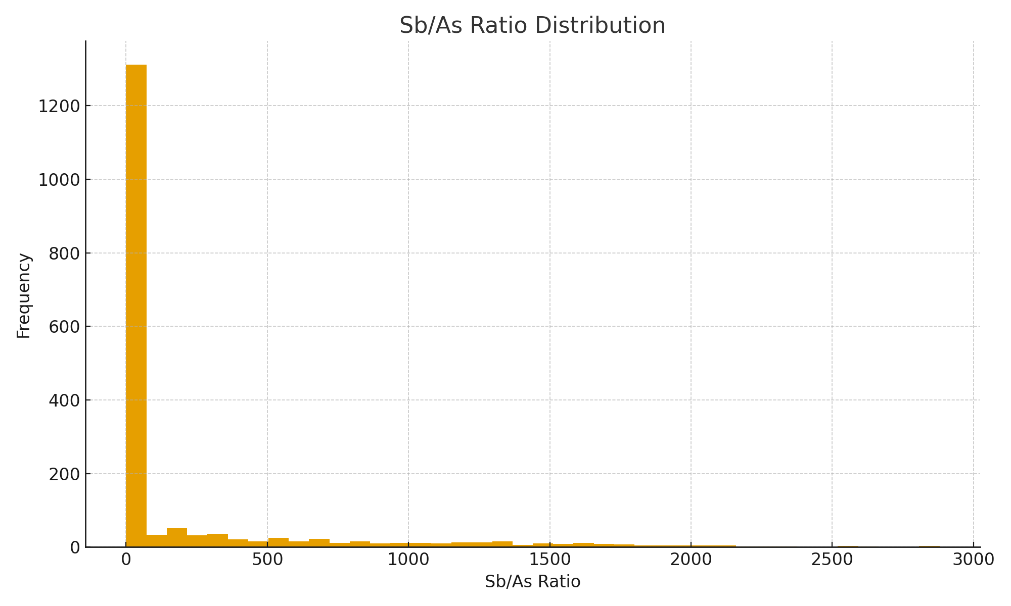
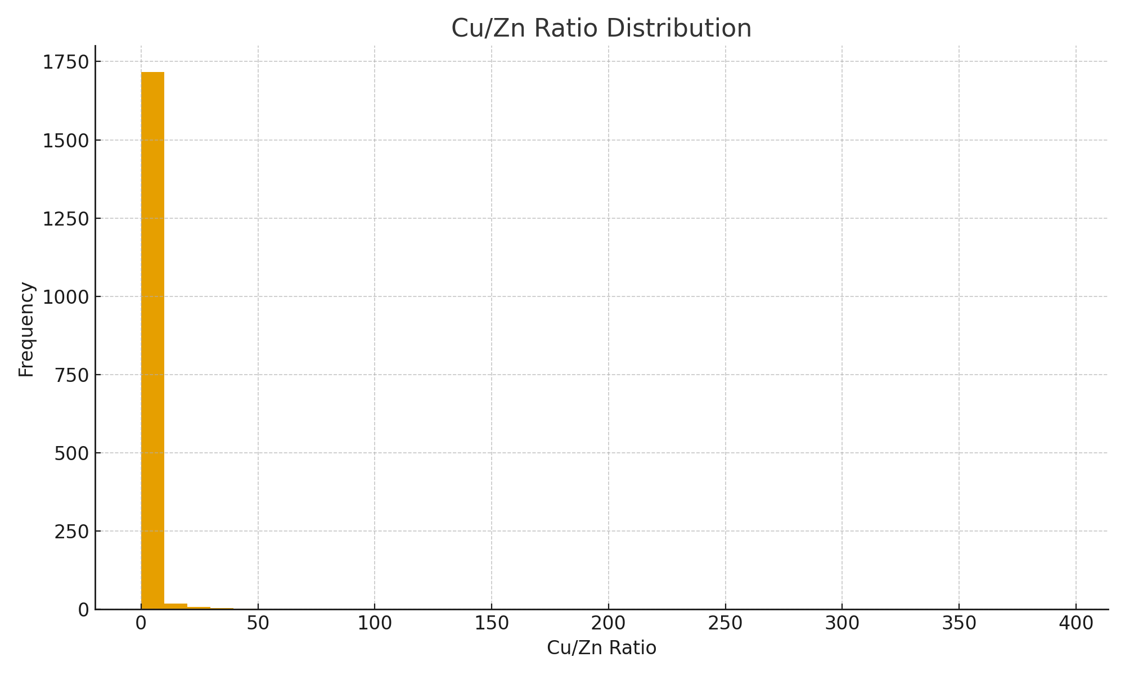

Slide 11



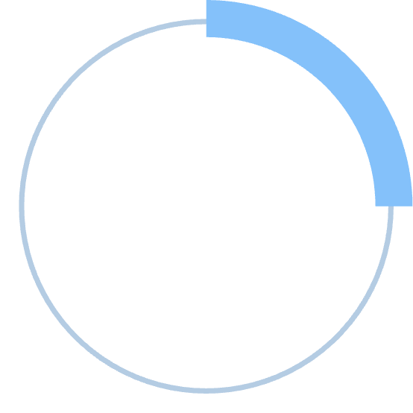
Geochemical Clustering Results
33%
42%
Cluster A
Cluster B
Core mineralized zone — high gold, high Sb/As, elevated Ag
Transitional halo — moderate pathfinder signals, intermediate gold
25%
Cluster C
Distal background — Zn-rich, low gold, low Sb/As
K-means clustering on multi-element geochemistry identifies three distinct geochemical domains that reinforce the zonation model from core to periphery.

Slide 12

3D Pathfinder Index Modeling
A conceptual As–Sb–Hg pathfinder index demonstrates multi-element signal behavior in 3D space, even without Hg assay data.
01
02
Index Construction
Spatial Visualization
Weighted combination of normalized pathfinder element values creates composite signal.
3D surface interpolation reveals vertical and lateral extent of mineralized envelope.
03
Gold Correlation
High index values systematically coincide with gold hotspots, validating the approach.

Slide 13
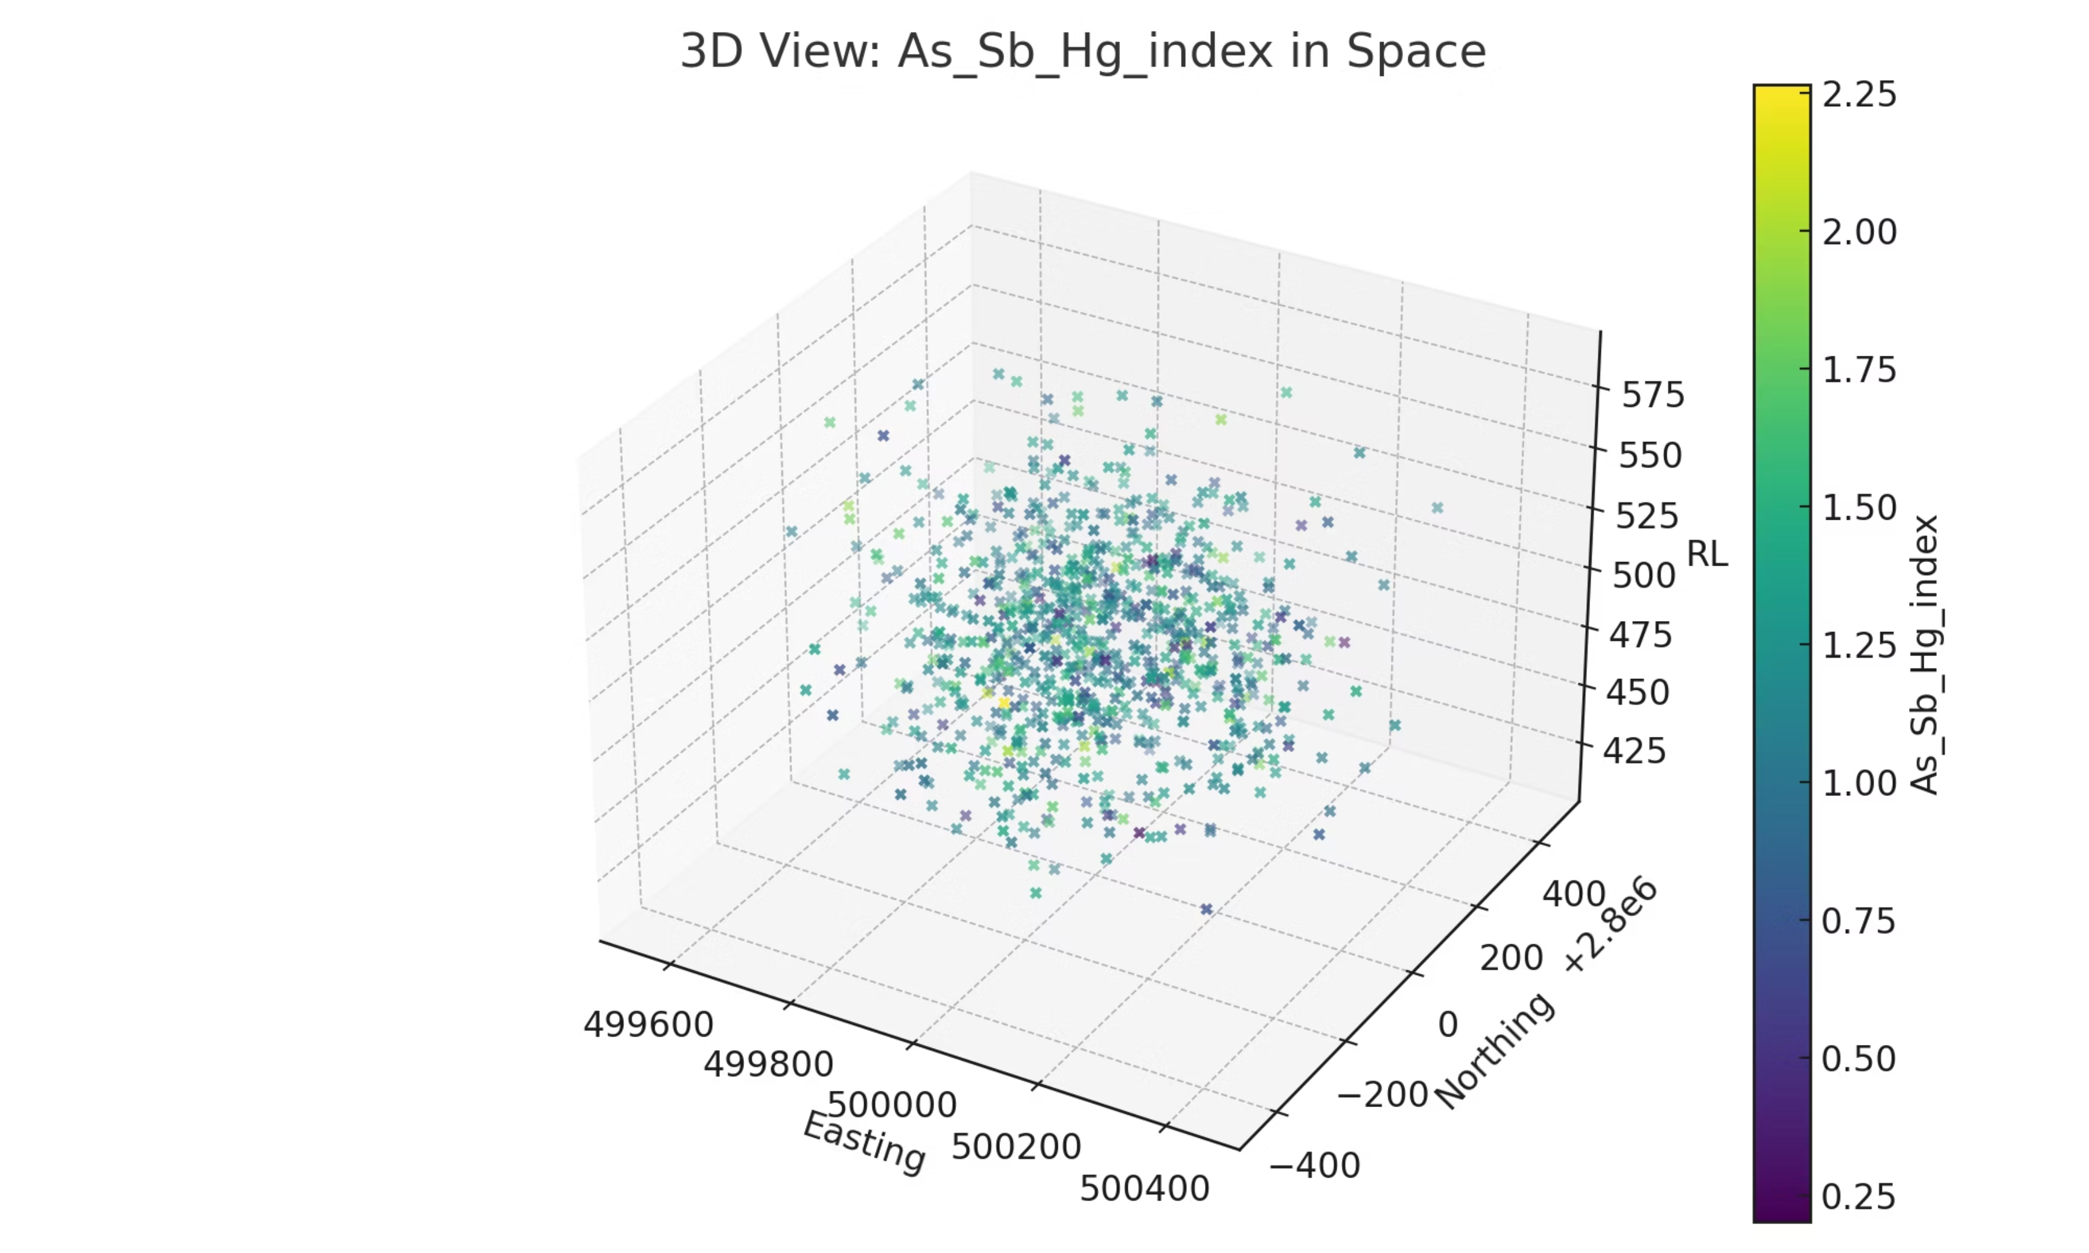

Slide 14


Geological Model Integration
Lithological Framework
Mineralization hosted primarily in granitic gneiss and sheared amphibolite units.
Structural Controls
High-grade zones align with regional-scale shear corridors and secondary splays. Structural dilation zones create fluid pathways.
Geochemical Validation
Sb/As ratios and cluster zoning patterns support structurally controlled core with outward geochemical gradients.
Deposit Classification: Orogenic gold system with characteristic pathfinder element associations and structural-lithological controls.

Slide 15

Key Findings and Exploration Impact
Pathfinder Success
Spatial Correlation
Sb/As ratios effectively reduce exploration uncertainty and vector toward high-gold zones.
High-gold zones cluster in central-eastern project area with strong geochemical signatures.
Zonation Model
Three-cluster geochemical model from core to periphery guides drill targeting.
This integrated approach demonstrates that combining Python-based geostatistics with multi-element pathfinder analysis significantly improves targeting efficiency in orogenic gold exploration, reducing reliance on direct gold assays alone.

Slide 16
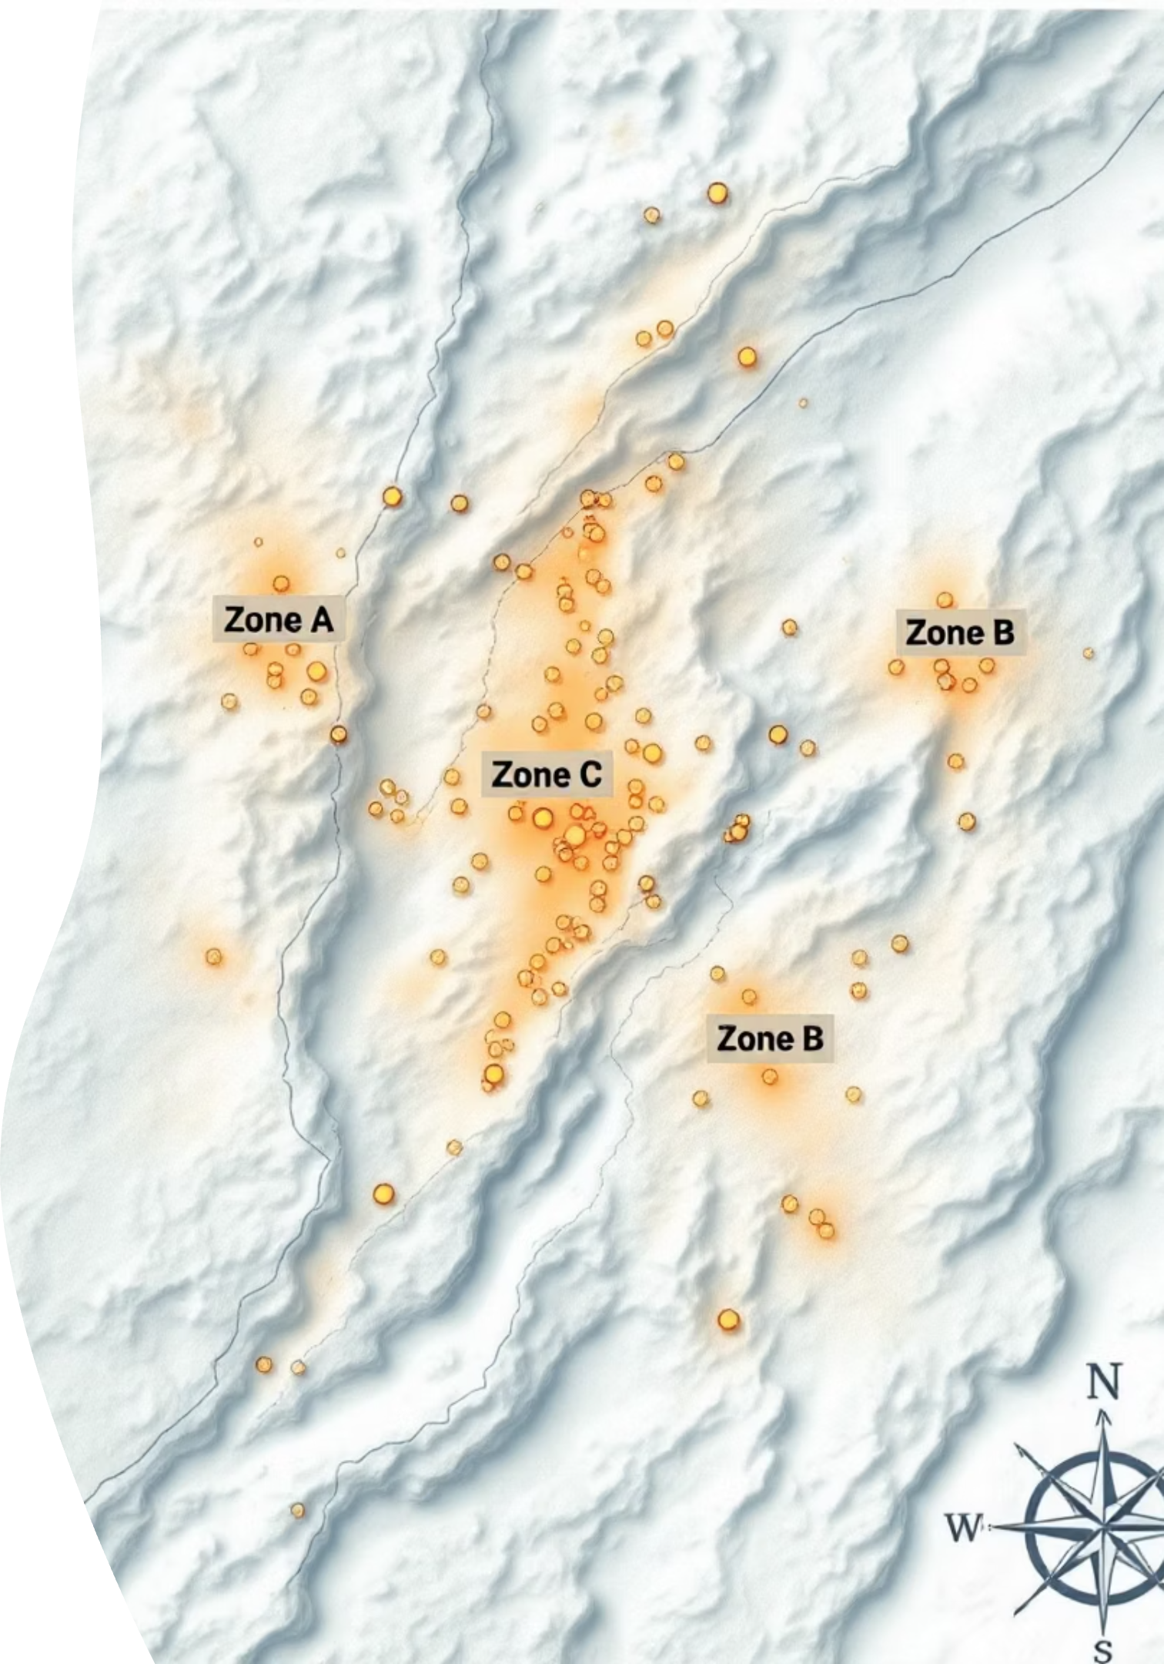
Slide 10 — Final Interpretation
This project successfully demonstrates that pathfinder elements and ratios significantly reduce uncertainty in gold exploration. Specifically, strong correlations have been identified between high-gold zones and Sb/As ratios, with these promising areas spatially clustered within the central-eastern part of the project.

Slide 17

Slide 11 — Impact & Value
Informed Drilling Decisions
The workflow provides data-driven insights, leading to more precise and effective drilling targets.
Improved Geological Understanding
Enhances comprehension of the orogenic gold system, revealing nuanced geological controls on mineralization.
Cost-Efficient Solutions
Utilizes open-source tools, significantly reducing reliance on expensive proprietary software in early exploration stages.
Reproducible Geochemical Model
Establishes a robust and repeatable geochemical model for ongoing and future exploration projects.

Slide 18

Thank You
We appreciate your time and consideration of the Shamkya Mining Project. We look forward to exploring these promising opportunities further.

